Slide 2
Partition Based Differential Testing for Finding Embedded Code Generation Bugs in Simulink
He Jiang, Hongyi Cheng, Shikai Guo, Xiaochen Li
School of Software, Dalian University of Technology
School of Information Science and Technology, Dalian Maritime University

Slide 3
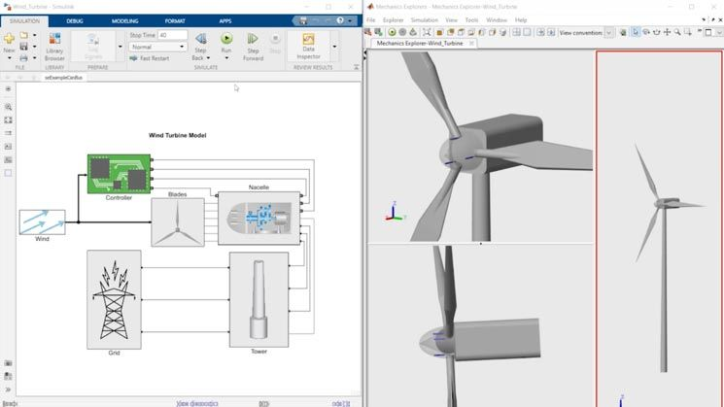
Background
Simulink
Widely used for developing cyber-physical systems
A graphical programming environment for modeling and simulation
Provide a block diagram editor for constructing Simulink models

Slide 4
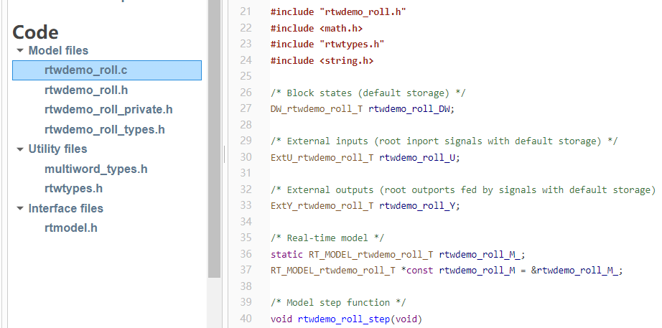
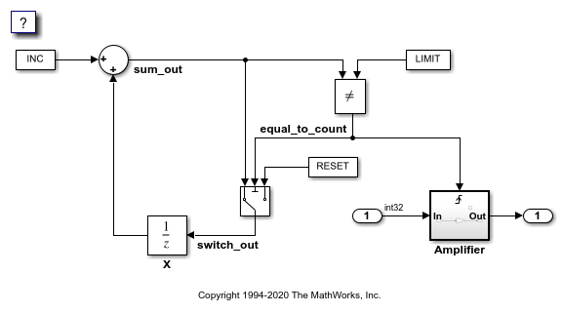
Background
Code generation in Simulink
The code generation process converts the Simulink model into source code (e.g., C source code) that can be executed on the target hardware platform
The generated code typically includes C functions and data structures that implement the behavior of the Simulink model
use
generate

Slide 5
Motivation
Bugs in code generation
Refer to errors that occur when converting Simulink models into executable code
Frequently happen in Simulink
Lead to unpredictable behavior or errors in the generated code when applied in real-world applications
System crashes, data corruption, memory overflow

Slide 6
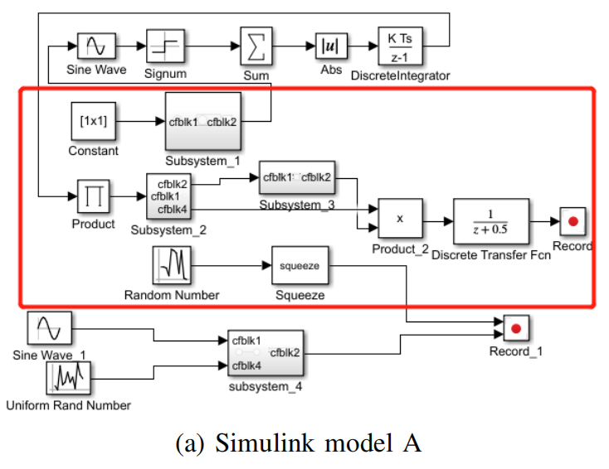
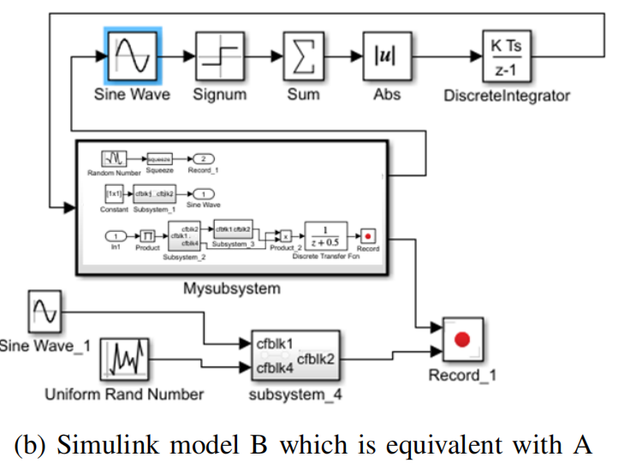
Motivation
A code generation bug example (Simulink TSC05794231)
When converting the red area in Figure (a) into C code using two different ways
1) Each block generates a C code function separately
2) The code of all blocks is encapsulated into a C function (b)
The generated code is inconsistent, producing different results for the same input

Slide 7
Motivation
A code generation bug example (Simulink TSC05794231) - Reason
During code generation, Simulink transforms the Sine Wave block in blue into the ‘sine’ method in the Standard C Library.
Input between −π and π: ‘sine’ works normally
Extremely large inputs (e.g., 1.74E+17): this method transforms the input value with the ‘eps’ method, and takes the transformed value as input, leading to a different output.

Slide 8
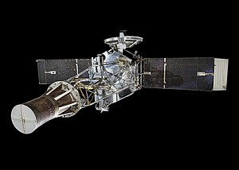
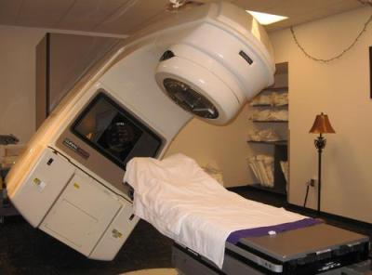
Motivation
Bugs in code generation
The generated code is often deployed in safety-critical applications
e.g., aerospace and healthcare
Bug in code generation can have serious consequences
Aerospace applications: loss of control of aircraft or system crashes
Healthcare applications: produce erroneous diagnostic results
Ensure the correctness and reliability of the generated code

Slide 9
Related Work – Simulink Testing
Differential testing
Generate Simulink models to trigger crash or miscompilation of Simulink
Generation-based: generate Simulink models from scratch
Cyfuzz (CyPhy 2016)
Slforge (ICSE 2018)
DeepFuzzSL (DeepTest 2020)
SLGPT (EASE 2021)
Mutation-based: mutate a Simulink model into a new one
SLEMI (ICSE 2020)
COMBAT (FSE 2022)
Equivalent Simulink configuration
Generation
S₁
Compare output
Model
S₂
Bugs
S_{n}
S₁ differs from other outputs
Equivalent Simulink model
Mutation
Model
Compare output
Bugs
C₁
S
C_{n}
C₁ differs from other outputs

Slide 10
Related Work – Simulink Testing
Differential testing
Generate Simulink models to trigger crash or miscompilation of Simulink
Generation-based: generate Simulink models from scratch
Cyfuzz (CyPhy 2016)
Slforge (ICSE 2018)
DeepFuzzSL (DeepTest 2020)
SLGPT (EASE 2021)
Mutation-based: mutate a Simulink model into a new one
SLEMI (ICSE 2020)
COMBAT (FSE 2022)
Equivalent Simulink configuration
Generation
S₁
Compare output
Model
S₂
Bugs
S_{n}
S₁ differs from other outputs
Equivalent Simulink model
Mutation
Model
Compare output
Bugs
These approaches test Simulink as a whole
They cannot find many/any code generation bug
C₁
S
C_{n}
C₁ differs from other outputs

Slide 11
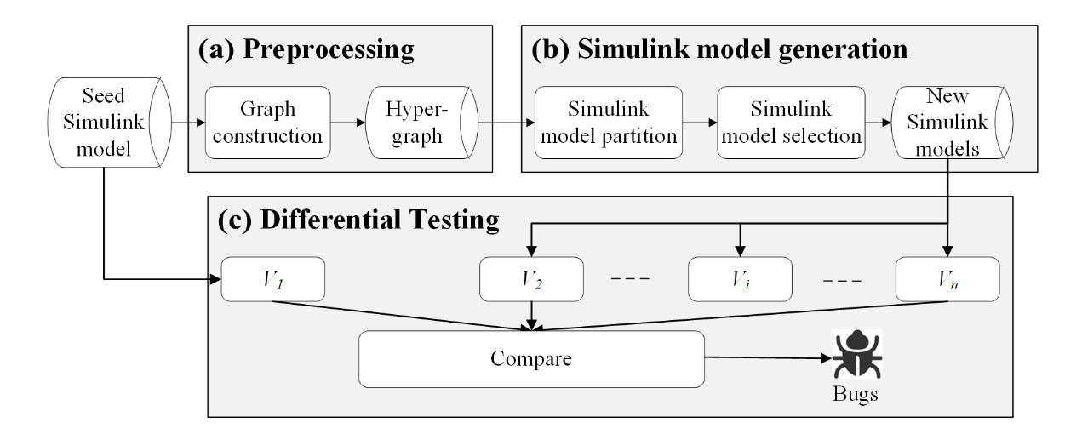
Framework – MOPART
MOdel PARTition based differential testing for code generation testing
Generate diverse and complex Simulink models to exercise the code generation process thoroughly for bug finding.

Slide 12
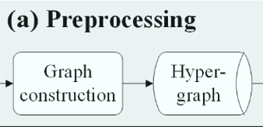
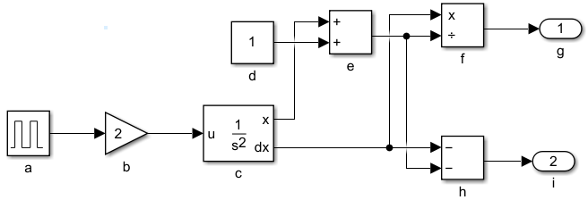
Framework
Preprocessing
MOPART transforms a Simulink model as a hypergraph
Blocks are taken as nodes
The data relationships between nodes are taken as hyperedges
n1
a
b
n5
f
g
d
e
f
g
n2
b
c
n6
h
i
n3
d
e
n7
c
f
a
b
c
h
i
n4
c
e
n8
e
h
h
Example of model preprocessing
f

Slide 13
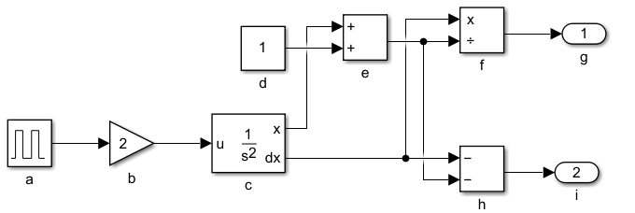
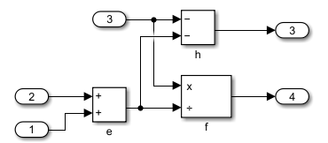
Framework
Simulink Model Generation
Generate source code from a seed Simulink model
The source code can be generated by setting a group of blocks as a subsystem
The final code is functionally equivalent, because only the structure is modified

Slide 14
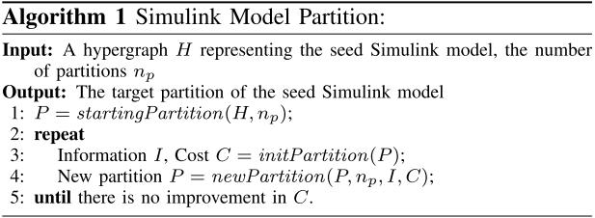
Framework
Simulink Model Generation
We identify blocks that can be put into a subsystem as a graph partition problem
Blocks strongly connected with each other should be in a subsystem
We partition the hypergraph with the Fiduccia-Mattheyses (FM) algorithm

Slide 15
Framework
Differential testing
Generate source code using two or more equivalent models
Compare the outputs of the generated code when feeding the same input
Seed model partition
Differential testing
Partition selection

Slide 16
Evaluation - Setup
Seed Simulink model
Use Simulink model generator SLforge to generate seeds
Each seed Simulink model has 100 blocks
Baselines
Default: compare the outputs of the seed Simulink model before and after code generation to find output inconsistency
Random: randomly select a subset of blocks in the seed as a subsystem
Testing period
The latest version of Simulink (R2022a) for two weeks

Slide 17
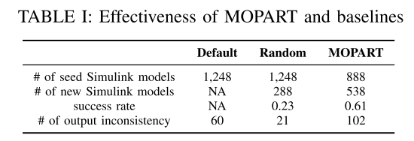
Evaluation - Effectiveness
Effectiveness of MOPART compared with baselines
MOPART executes 888 seed Simulink model
MOPART generates 538 valid Simulink model (that is equivalent with the seed)
MOPART is effective in generating Simulink models to trigger more code generation inconsistency compared with baselines (102 vs. 21 and 60)

Slide 18
Evaluation - Parameters
Impact of the number of partitions
Configure the number of partitions (n_{p}) from 5 to 20 with a step size of 5
The number of partitions affects the efficiency and effectiveness in generating source code and finding output inconsistency
MOPART can find a high number of output inconsistency with n_{p} = 15

Slide 19
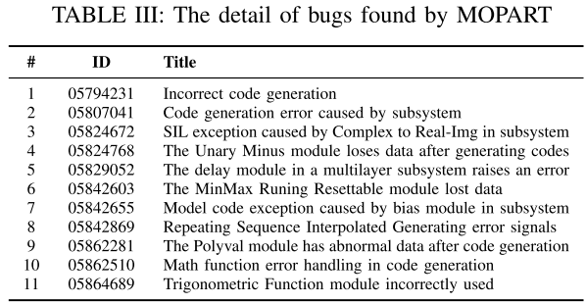
Evaluation – Find Real Bugs
Finding real code generation bugs
Report non-duplicate bugs to developers
11 bugs are confirmed
Related to Delay, Bias, Polyval, and Math blocks
Bug analysis
The difference between language specifications of Simulink and C/C++ can cause bugs
Simulink may improperly deal with subsystems during code generation.
The generated code may not correctly compute special input values (e.g., NaN)

Slide 20
Conclusion
Simulink converts the Simulink model into source code to deployed in safety-critical applications
The code generation module can have bugs, leading to unexpected behavior in the generated code
We propose MOPART to generate diverse and complex Simulink models to exercise the code generation process thoroughly for bug finding
MOPART find 11 confirmed code generation bugs in Simulink related to various Simulink blocks

Slide 21
Thanks
Partition Based Differential Testing for Finding Embedded Code Generation Bugs in Simulink
Authors: He Jiang, Hongyi Cheng, Shikai Guo, Xiaochen Li
School of Software, Dalian University of Technology
School of Information Science and Technology, Dalian Maritime University

